Slide 1
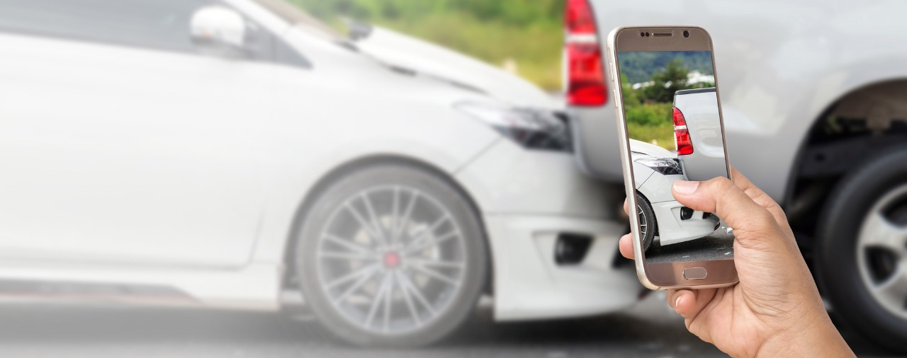
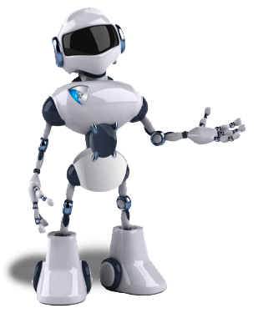

Auto Car Insurance Claim
User Manual
: krishnakumarsekar

Slide 2
Application Links and Login Details
Production URL
https://carinsuranceclaim.herokuapp.com
Support all Browsers including PC, Mobile and Tablet
Login Details
For Security Reason its be the part of the mail. Kindly check the mail received
Android APK
https://carinsuranceclaim.herokuapp.com/apps/apk/carinsuranceclaim.apk
Not Mandatory to install . only for app likers
iOS iPA
Due to Developer / Provisional Certificate . iPA cannot be installed in all devices
If want please download the source code and add the production url and click generate in xcode
Not Mandatory to install . only for app likers
License Details
All APIs and Production URL running under the user name krishna kumar sekar

Slide 3
Scenario 1 : Happy Scenario. How a customer can claim for a real damage
Pre requisite:
Any PC Browser or Mobile Device Browser
In IPhone Safari Private Mode alone wont work
Damage Image Sample
https://carinsuranceclaim.herokuapp.com/testimages/test%20_happy_flow.jpg
Download the image in local
Testing Purpose Contract ID - 567825-234567
Copy Session ID as per the next slides – it be alive for 20- 30 mins

Slide 4
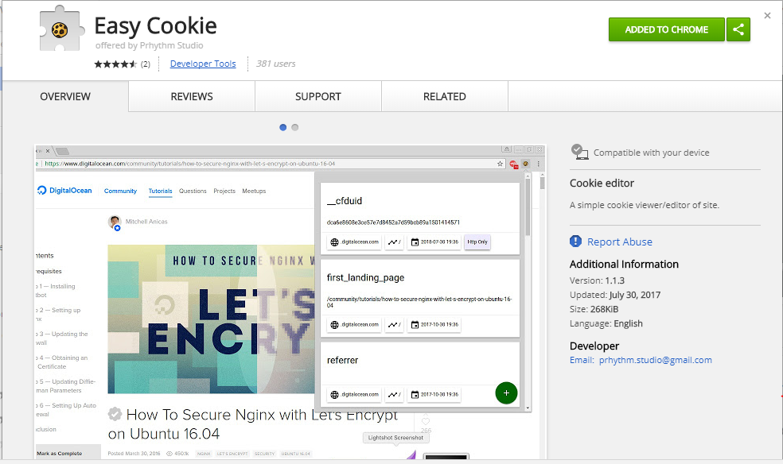

Session ID for TCS Api (For Security Reason Automatic Generation avoided, Will apply based on need to make it automatic)
Install the Extension/add-on or Chrome app easy-cookie
https://chrome.google.com/webstore/detail/easy-cookie/lhjmodgjifeldjjjbdpbkeckpphoapea?hl=en
You will get the icon in the in the menu bar if its installed successfully

Slide 5
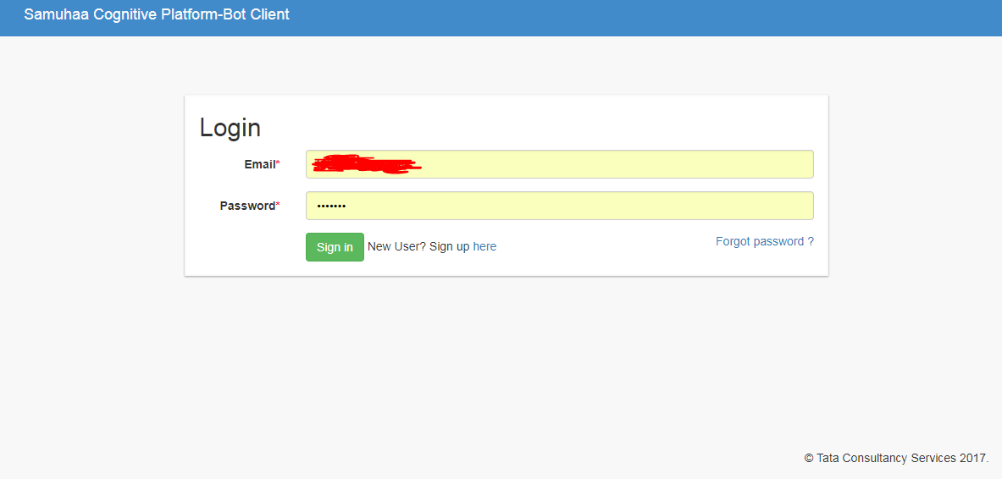
Login to the below URL
http://samuhaa.com/bots/login
Credentials be the part of the mail

Slide 6
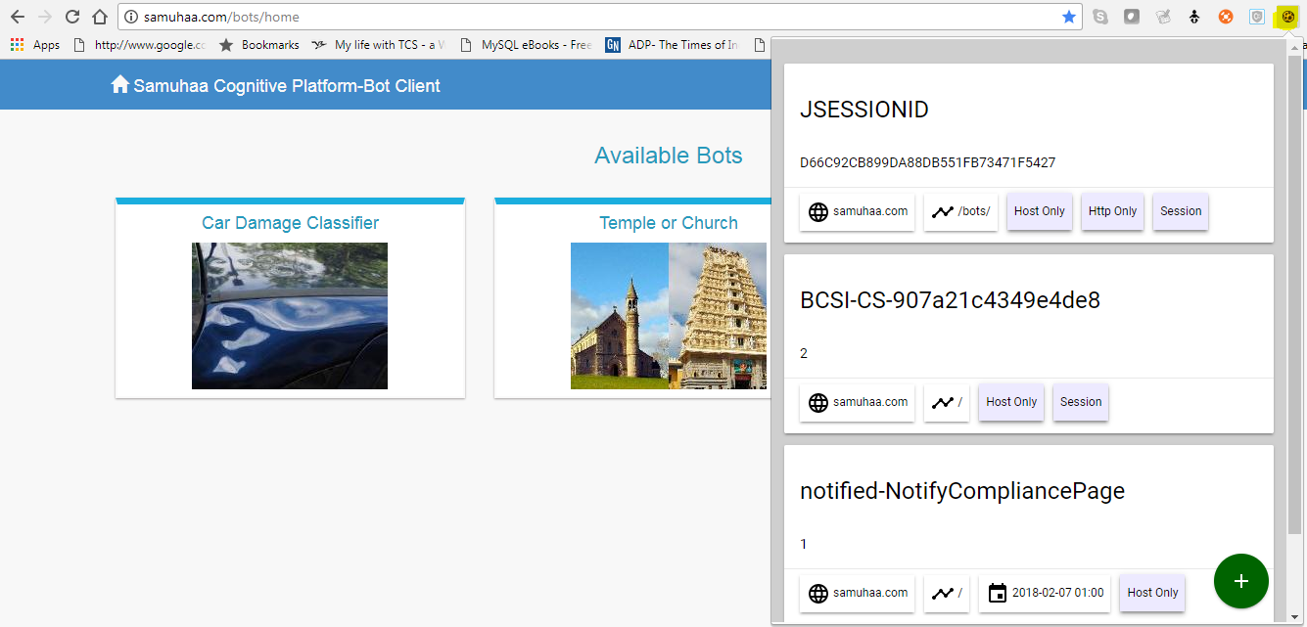
Login to the below URL
http://samuhaa.com/bots/login
Credentials be the part of the mail
Copy the JSESSIONID by clicking the yellow highlighted icon
For easy Mobile Usage . Kindly try one time in PC , Your session ID will get prepopulated as option in APP and Mobile Browser if you logged in with Google Account in same PC and Mobile

Slide 7
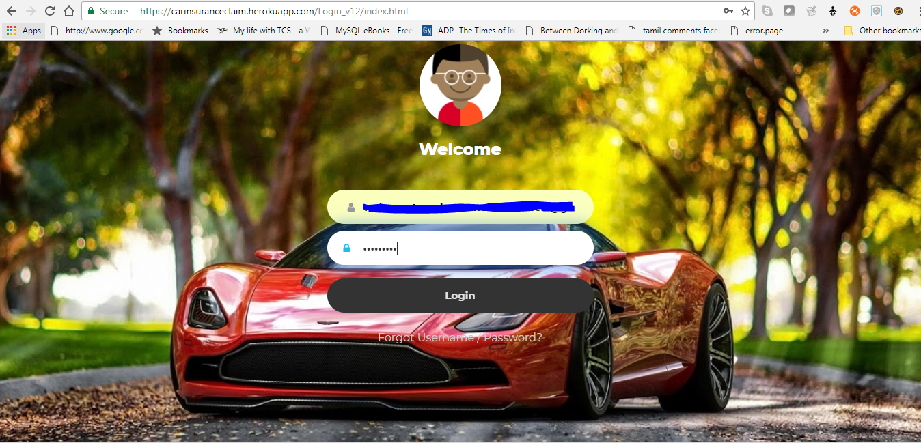
Let’s Start : Do a Login

Slide 8
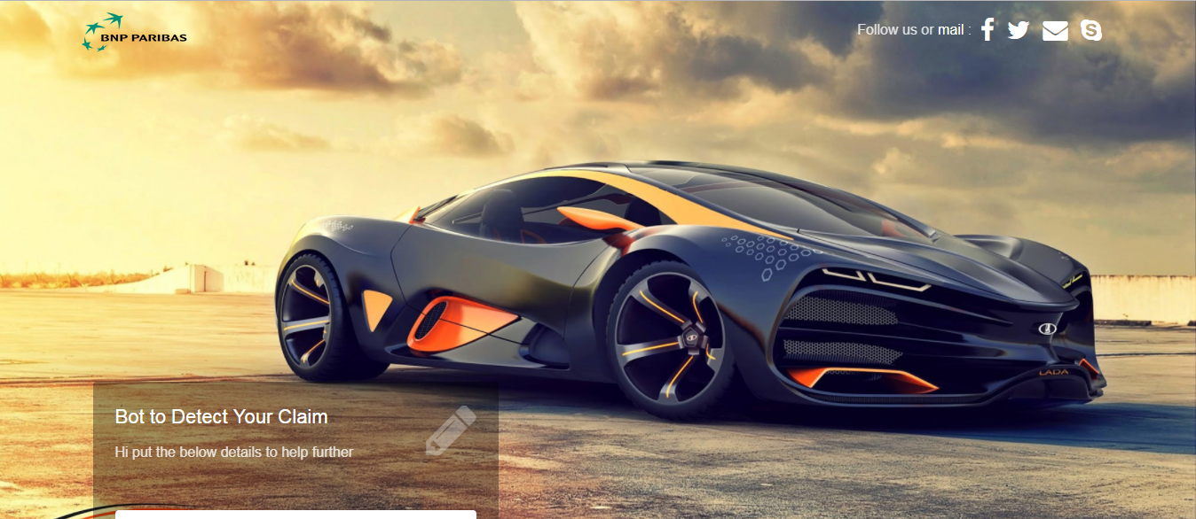
Get Redirected to this page

Slide 9
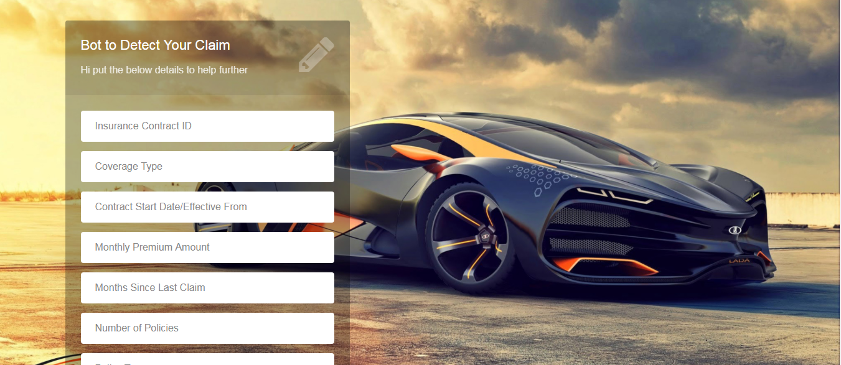
Scroll Down to enter the details

Slide 10
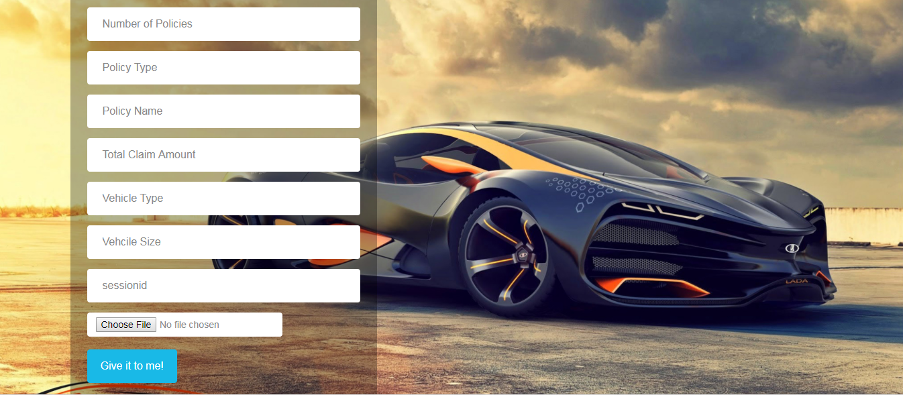

Slide 11
Enter all the details if want to do a try as per the Description Presentation or else enter the contract id in pre requisite.
All data’s will be prepopulated

Slide 12
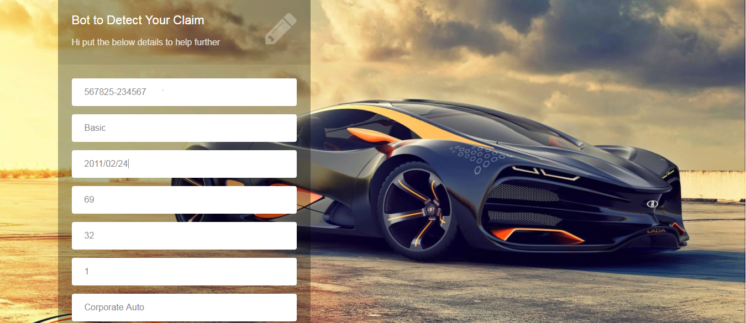

Slide 13
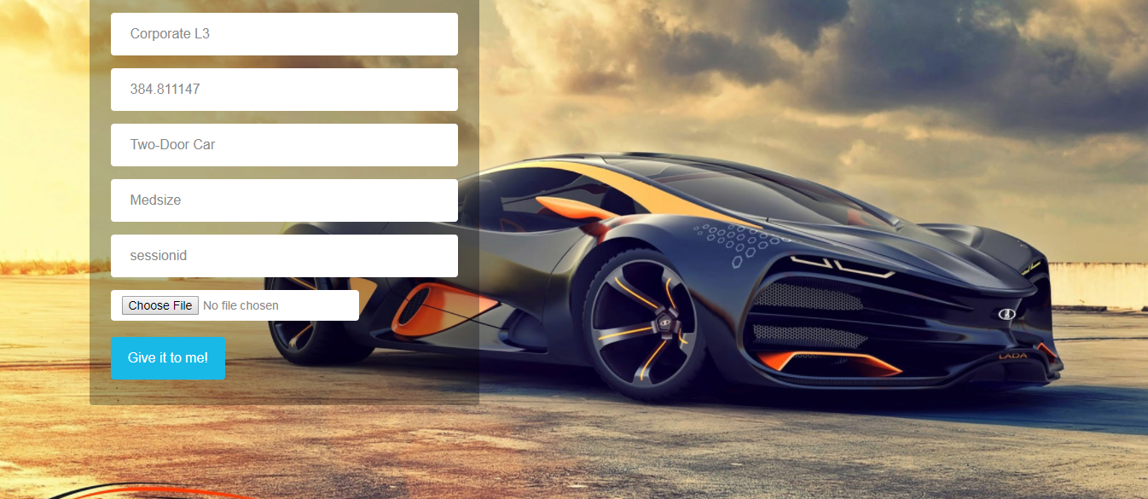

Slide 14
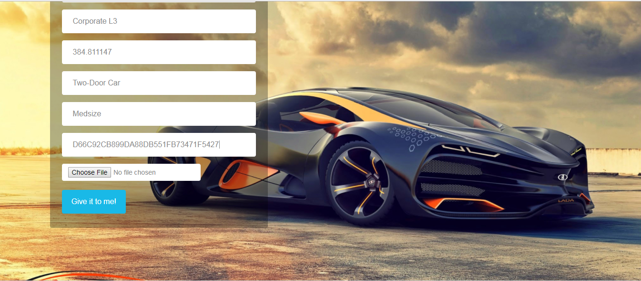
Paste the session ID copied as per the pre requisite

Slide 15
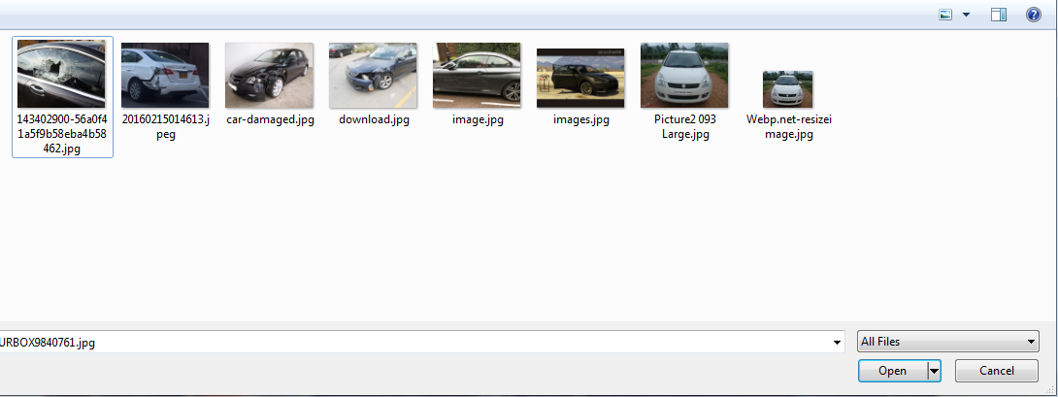
Select the image by clicking choose file

Slide 16
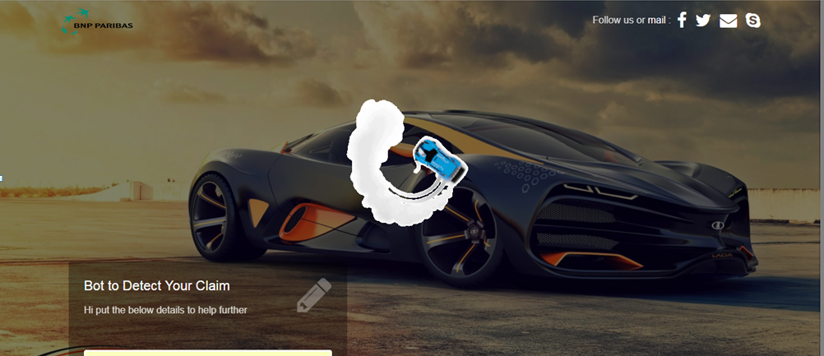
That’s Solve you will get the result as per the screens

Slide 17
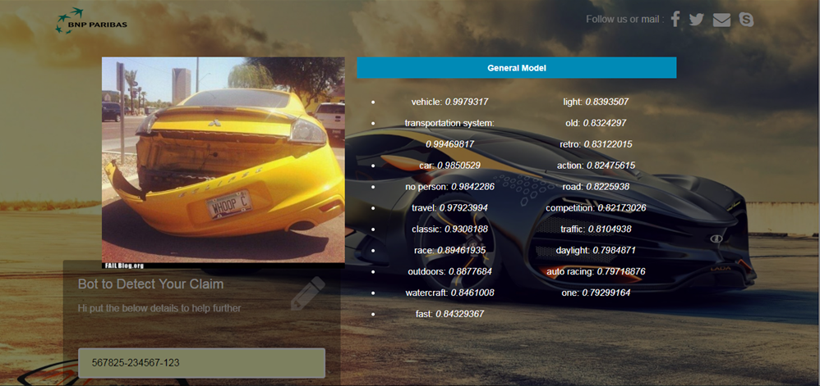

Slide 18
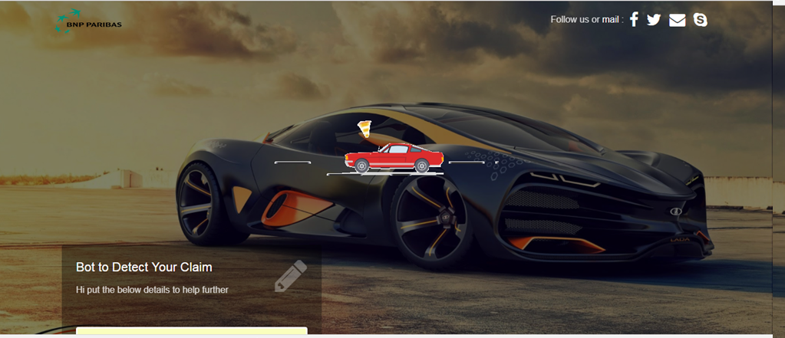

Slide 19
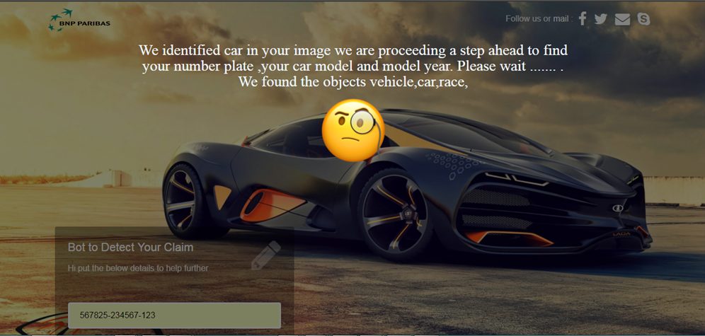

Slide 21
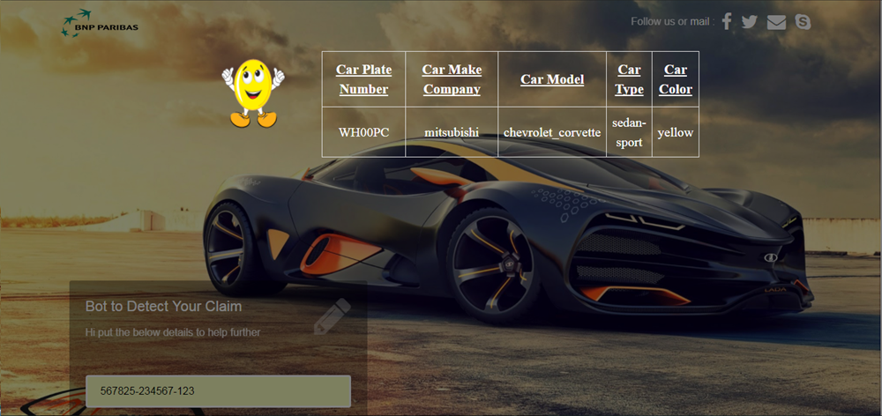

Slide 23
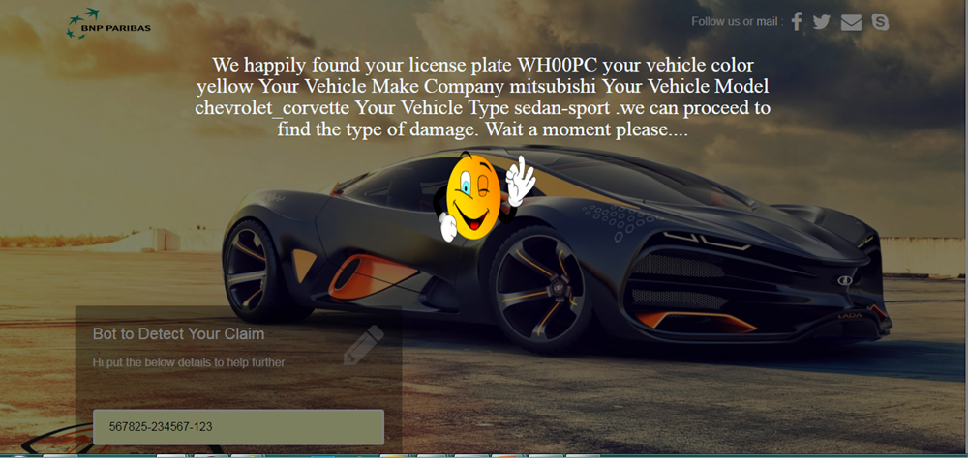

Slide 25
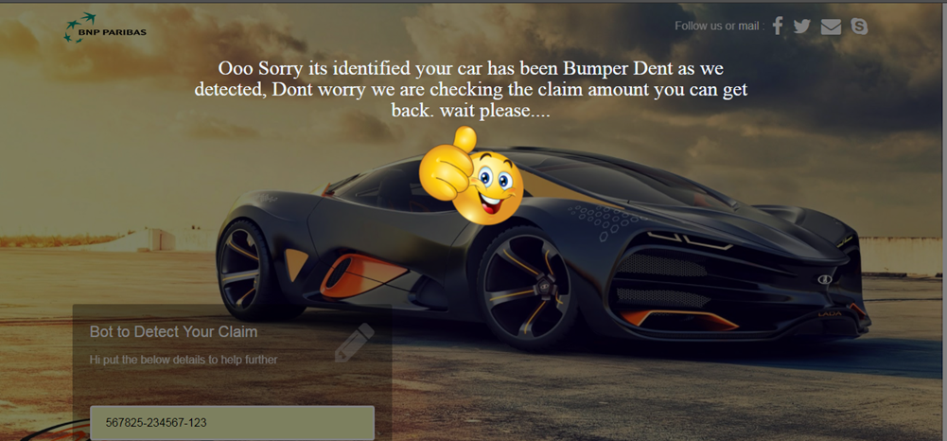

Slide 26
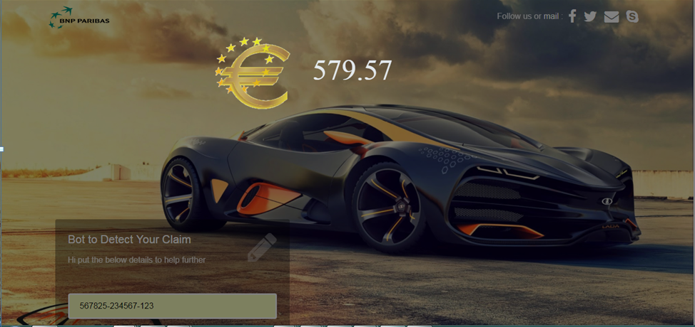

Slide 27
Scenario 1 : Test Validation
Output Results
Car model = “chevrolet corvette”
User Contract Vehicle Type = “Two Door”
User Contract Vehicle Size = “Medsize”
Claim Amount = “579.57”
Test Results
Checked in Google and validated as Output Result is 80 Percent correlated wit Internet Results

Slide 28
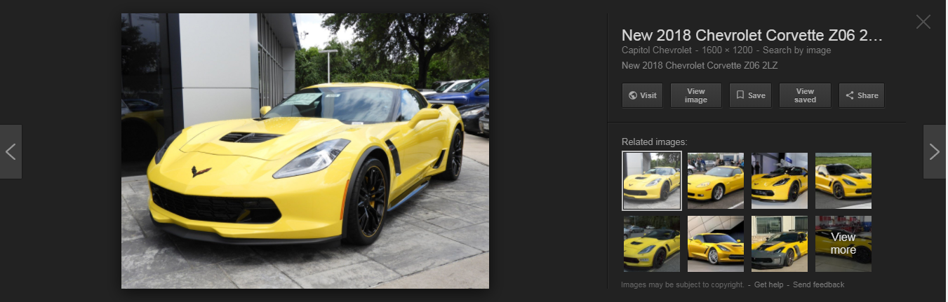
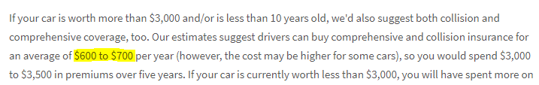
Google Result Saying It’s a two door car and it’s a medium size car and average 600 to 700 dollars

Slide 29
Scenario 2 : Happy Scenario. How a customer Get Blocked while using Car Image of Unknown Person
Pre requisite:
Any PC Browser or Mobile Device Browser
In IPhone Safari Private Mode alone wont work
Damage Image Sample
https://carinsuranceclaim.herokuapp.com/testimages/Lamborgani.jpg
Download the image in local
Testing Purpose Contract ID - 567825-234567
Copy Session ID as per the scenario 1 – it be alive for 20- 30 mins
Mandatory the Vehicle Type Not be Luxury

Slide 30
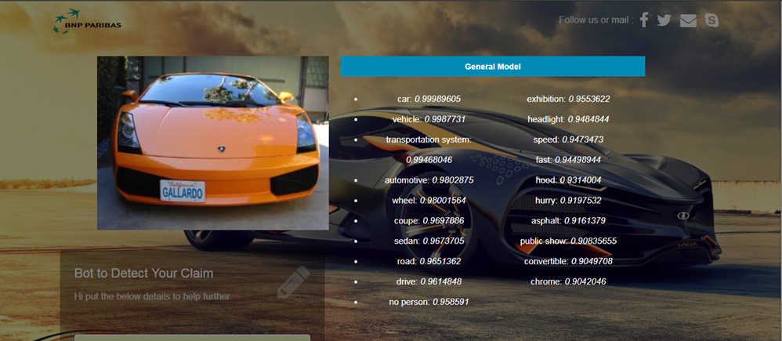

Slide 31
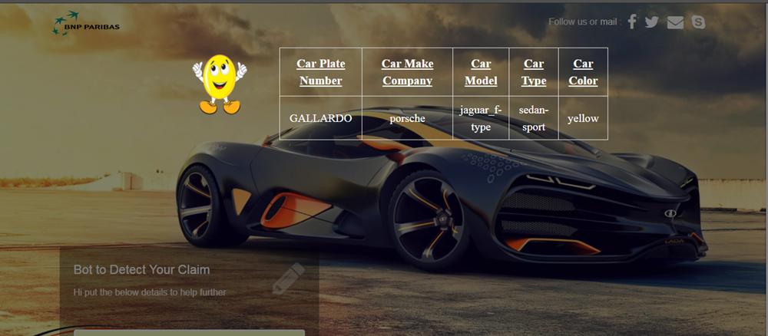

Slide 32
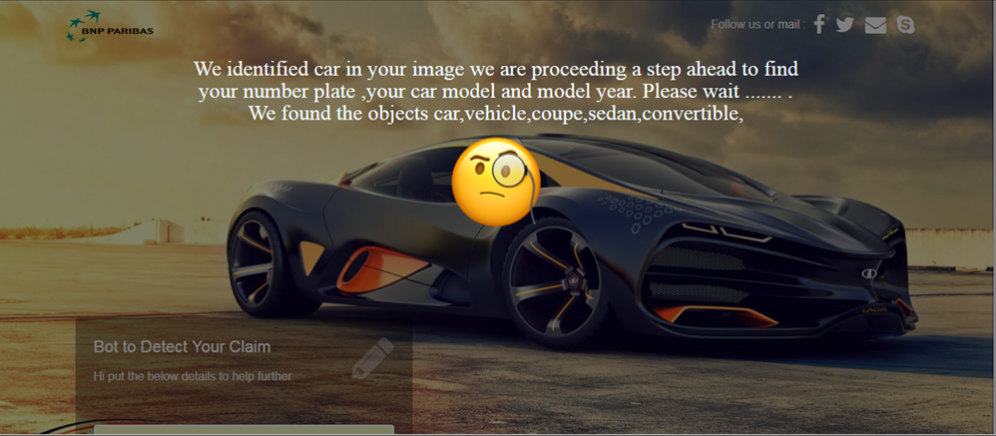

Slide 33
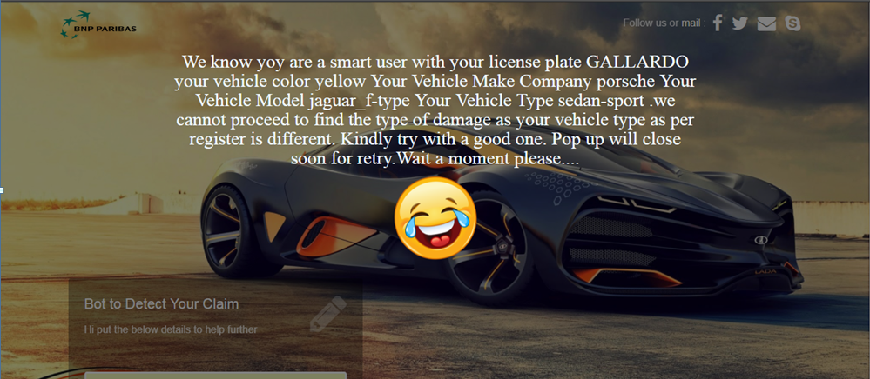

Slide 34
Scenario 2 : Test Validation
Test Validation
In Straight way we can say the car is a luxury car , But the user is a two door user
So the result is correct

Slide 35
Scenario 3 : Happy Scenario. How a customer Get Blocked while using Car Image With No Damage
Pre requisite:
Any PC Browser or Mobile Device Browser
In IPhone Safari Private Mode alone wont work
Damage Image Sample
https://github.com/krishnakumarsekar/auto-car-insurance-claim/blob/master/corvette-c7-stingray-rt-2014-025.jpg
Download the image in local
Testing Purpose Contract ID - 567825-234567
Copy Session ID as per the scenario 1 – it be alive for 20- 30 mins

Slide 36
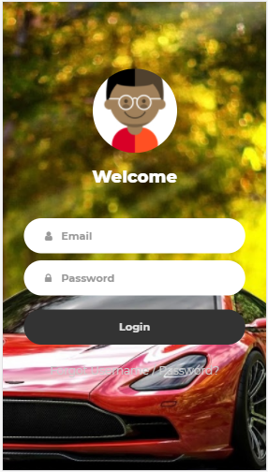
This time the flow is in iPhone 7

Slide 37
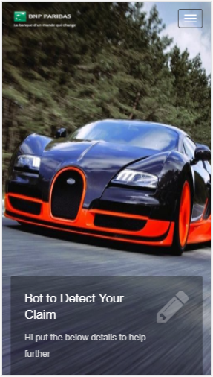
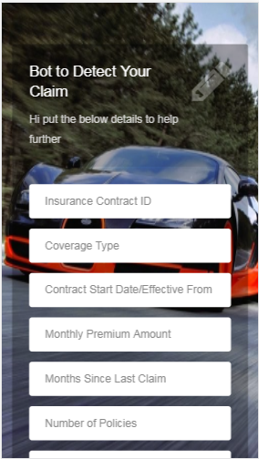
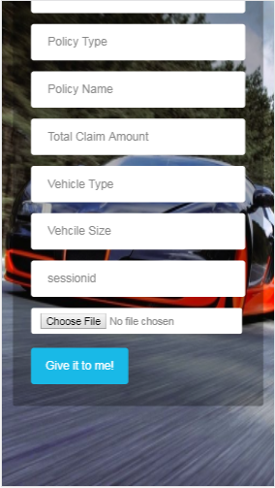

Slide 39
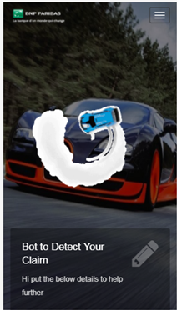
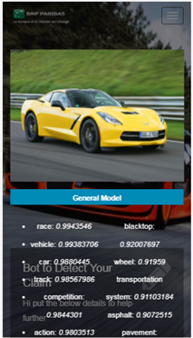
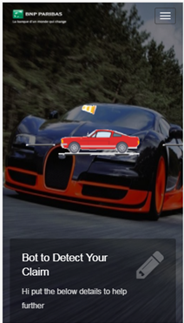
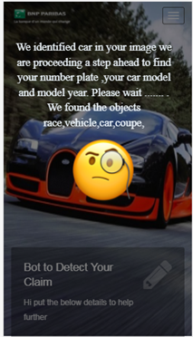

Slide 40
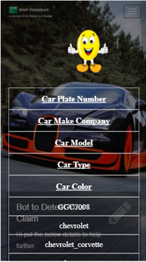
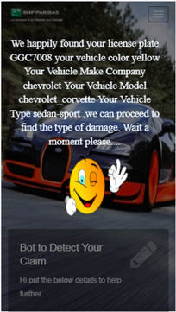

Slide 41
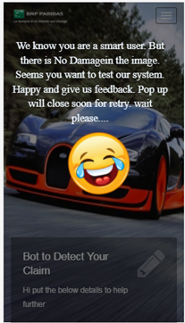

Slide 42
Scenario 3 : Test Validation
Test Validation
In Straight way we can say no damage in car
So the result is correct

Slide 43
Scenario 4 : Happy Scenario. How a customer Get Blocked while using Unknown Image
Pre requisite:
Any PC Browser or Mobile Device Browser
In IPhone Safari Private Mode alone wont work
Damage Image Sample
Download any Image from internet . But Mandatory No car object
Testing Purpose Contract ID - 567825-234567
Copy Session ID as per the scenario 1 – it be alive for 20- 30 mins

Slide 44
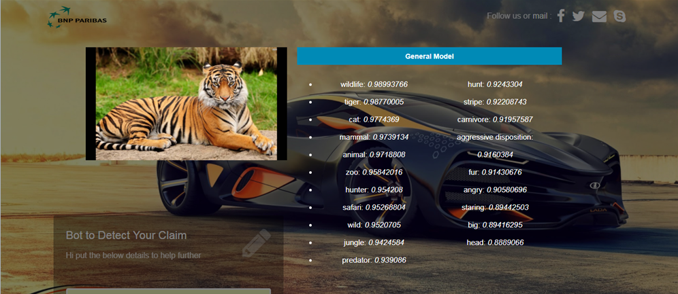

Slide 45
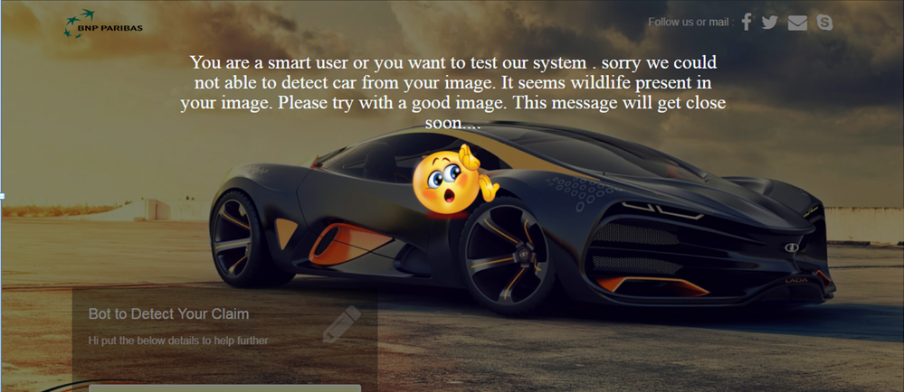

Slide 46
Scenario 4 : Test Validation
Test Validation
In Straight way we can say its tiger
So the result is correct

Slide 47
Scenario 5 : Changes in amount value while changing a Basic coverage type to Premium
Pre requisite:
Any PC Browser or Mobile Device Browser
In IPhone Safari Private Mode alone wont work
Damage Image Sample
https://carinsuranceclaim.herokuapp.com/testimages/test%20_happy_flow.jpg
Download the image in local
Testing Purpose Contract ID - 567825-234567
Copy Session ID as per the scenario 1 – it be alive for 20- 30 mins
Change the type of the coverage from Basic to Premium

Slide 48
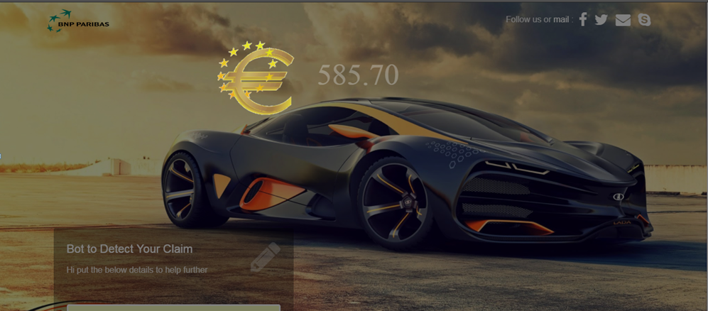

Slide 49
Scenario 5 : Test Validation
Test Validation
We did not done any change in the monthly payment as well other values . Just switched the user from basic to premium .
We can see a small increase in the amount of 10 Euro
Which conclude the logic wise its working fine

Slide 50
Multiple scenarios
By changing the User Type from Basic, Premium and Extended we can see the amount variation
By changing the vehicle type and vehicle size
By making an image with scratch and how the amount varies

